Slide 1
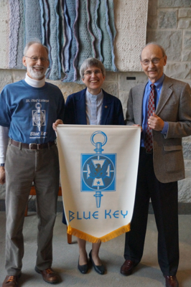
Blue Key Honor Society
Induction Ceremony
November 10, 2013
2:00 p.m.
Norway Room
St. Olaf College

Slide 3
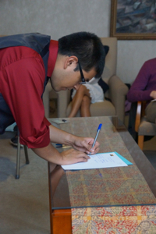
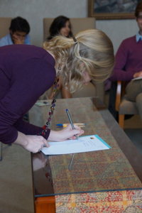

Slide 4
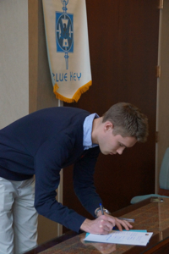

Slide 5
