Slide 1
Effects of Faith Counseling in the Promotion of HIV Screening in District Level Health Clinics in Tanzania
By: Ella Hagopian and Victoria Knutson

Slide 2
1.
Introduction
Research Question, Purpose, Literature Review

Slide 3
Research Question
Our primary question is whether the implementation of faith-related counseling in district level general health clinics has an impact on the uptake of HIV screening resources.
Which demographics most affected?
Which demographics least likely to utilize HIV testing?
Hypothesis: Our hypothesis is that employing faith counseling in the district level health clinics will be associated with an increase in the amount of people who choose to get tested for HIV.
H_{o}: P_{FCG} - P_{CG} = 0
H_{a}: P_{FCG} - P_{CG} > 0

Slide 4
Background: Purpose
Notes:
SYSTEMATIC!!!!!!!

Slide 5
Background: Purpose
90-90-90 goal- study is targeting that first 90%
But societal anathema prevents from reaching that goal
Society is very religious, religion already plays large role in healthcare
Determine how to reach populations like males, who don’t get tested
Limited resources in Sub-Saharan healthcare system so it’s important to pinpoint the strategies that have the largest impact on reaching their healthcare goals
In 2018, $91 billion in expenditure on HIV epidemic in ONLY Tanzania
HIV tests are a free service
Notes:
SYSTEMATIC!!!!!!!

Slide 6
Background:
Lit Review
Nigeria study of congregation-based intervention, Ezeanolue, Echezona et al.
Found that 92% pregnant women in the intervention group had an HIV test compared with 55% in the control group
Associated factors: employment and low number of previous pregnancies
Elder, J P et al. and Drake, Bettina F et al. studies in the US revolving around faith-based interventions
Cancer screening among church-going Latinas and prostate cancer screening among African-American men
Njau, Bernard et al. studied HIV testing preferences in Tanzania, which highlighted importance of quality of care, including trust of the healthcare practitioner, and confidentiality
Sharma M, Barnabas RV, Celum C (2017) Community-based strategies to strengthen men’s engagement in the HIV care cascade in sub-Saharan Africa
Notes:
Nigeria is even less religious than Tanzania, only 87% of the population “practicing”

Slide 7
2.
Study Design
Variable Selection, Inclusion/Exclusion Criteria, Ethical Considerations, Subject Recruitment & Consent, Randomization, Data Collection & Follow Up

Slide 8
Variables
OUTCOME MEASURE
Whether the patient chose to be screened for HIV (binary yes/no)
PREDICTORS
Main predictor of interest: whether or not the patient received faith counseling during the consultation
General demographics: gender, age, education level, employment status, religion
Factors influencing choice: distance from the clinic, when they were last tested for HIV, current diagnosis/reason for visiting

Slide 9
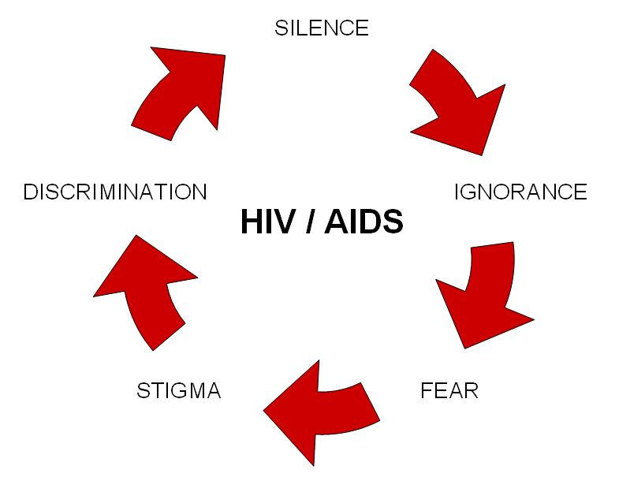
Potential Confounding Variables
Individual’s stigma against HIV & HIV testing
Religious views
Promotion at church

Slide 10
Inclusion/Exclusion Criteria
INCLUDE
Age 16+
All religious affiliations & non-religious
EXCLUDE
Already HIV positive
People who are not comfortable disclosing their religion

Slide 11
Ethical Considerations
Context of Tanzania: limited resources, highly religious society, high prevalence of HIV
the study’s findings will be specifically applicable and beneficial for the Tanzanian population
Clinical equipoise
Undue religious influence
Favorable risk to benefit ratio: free education for all subjects
Age of consent
Notes:
“Mature” minors

Slide 12
Subject Recruitment Plans & Consent Process
Whoever comes in on the specified trial days to the clinics will be eligible to be included in the trial. The randomization will then happen at the clinic level.
Consent: Opt in and they will know that we will ask about religion.
Consent document will be offered in English, Swahili, and native tribal languages

Slide 13
The Process
After normal consultation, faith counselor comes in to talk about getting tested
If they fit criteria, they will be asked to participate & review consent form
Treatment
Patient visits clinic
Control
After normal consultation, healthcare professional talks about getting tested

Slide 14
Randomization & Blinding Method
RANDOMIZATION
One-stage clustering randomization
More cost-effective
Reduces logistical issues
Reduce treatment group contamination
BLINDING
No blinding
Notes:
One stage = study includes all participants who visit every randomly selected clinic (as opposed to only selecting a certain number of people visiting each clinic)

Slide 15
Data Collection & Follow Up
DATA COLLECTION PROCEDURE
Patient self-reports: gender, religion, age, education level, distance from health facility, when they were last tested for HIV, employment status
Healthcare professional reports: diagnosis for visit, choice to be screened or not
FOLLOW UP
No follow up -- we only want to see decisions immediately after receiving counseling

Slide 16
3.
Statistical Plan
Sample Size, Length of Study, Statistical Methods, Limitations & Issues

Slide 17
Sample Size
Donner, Birkett, and Buck’s sample size formula for a comparison of proportions in a cluster randomized trial with binary outcomes
alpha= 0.05
power= 0.80
P_{C} = 0.25 ← from literature
P_{E} = 0.35
n= 60 ← from literature, average daily health clinic attendance of 95 patients, with an expected already HIV positive percentage of 5% and estimated elective study enrollment rate of ⅔
k= 0.10 ← from literature
From this calculation we found that we need 358 subjects and 6 clusters per arm (control, treatment) of the trial.

Slide 18
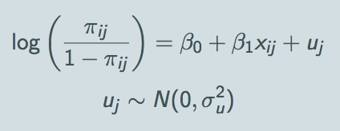
Statistical Methods
Multi-Effect Logistic Model → binary outcomes, logit link function
Interpretation of the fixed effect:
β0 is the log-odds that y = 1 when x = 0 and u = 0
β1 is effect on log-odds of 1-unit increase in x for individuals in same group (same value of u), often referred to as cluster-specific or unit-specific effect of x
Interpretation of the random effect:
Uj is the effect of being in group j on the log-odds that y = 1; also known as a level 2 residual
Two-proportion z test

Slide 19
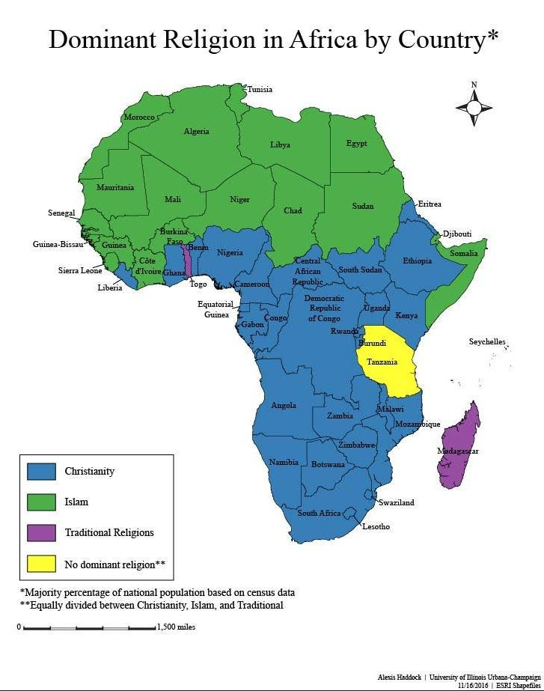
Limitations & Issues
Religious makeups of specific areas & asking about religion in a hospital setting
No follow up
HIV stigma
Patient is self-reporting most of their own information
Notes:
Self report -- we could cross validate on last tested

Slide 20
4.
Funding

Slide 21
Potential Funding Sources
American Foundation for AIDS Research (amfAR)
If they have a new request for proposals in the near future
NIH/Dept of Health and Human Services grant for social science HIV prevention and care
Grant offer expires in early 2020 so we could still have time to apply
No limit to budget request
Notes:
https://grants.nih.gov/grants/guide/pa-files/PA-18-273.html Targeted basic behavioral and social science intervention development for HIV prevention and care

Slide 22
Thanks!
Questions?

Slide 23
References
Drake, Bettina F et al. “A church-based intervention to promote informed decision making for prostate cancer screening among African American men”Journal of the National Medical Association vol. 102,3 (2010): 164-71. https://www.ncbi.nlm.nih.gov/pmc/articles/PMC2913684/
Elder, J P et al. “Promoting cancer screening among churchgoing Latinas: Fe en Acción/faith in action” Health education research vol. 32,2 (2017): 163-173. https://www.ncbi.nlm.nih.gov/pmc/articles/PMC5914432/
Ezeanolue, Echezona et al. “Effect of a congregation-based intervention on uptake of HIV testing and linkage to care in pregnant women in Nigeria (Baby shower): a cluster randomized trial” The Lancet Global Health vol. 3,11 692-700. Nov. 2015, doi: 10.1016/S2214-109X(15)00195-3 https://www.sciencedirect.com/science/article/pii/S2214109X15001953
https://www.satregional.org/wp-content/uploads/2018/05/Age-of-consent-Tanzania.pdf
Njau, Bernard et al. “HIV testing preferences in Tanzania: a qualitative exploration of the importance of confidentiality, accessibility, and quality of service” BMC public health vol. 14 838. 12 Aug. 2014, doi:10.1186/1471-2458-14-838 https://www.ncbi.nlm.nih.gov/pmc/articles/PMC4141951/
Saunders, Donna M et al. “Application of a faith-based integration tool to assess mental and physical health interventions” Journal of the Georgia Public Health Association vol. 7,1 (2017): 26-38. https://www.ncbi.nlm.nih.gov/pmc/articles/PMC5771442/
Victor RG et al, A cluster randomized trial of blood pressure reduction in black barbershops, N Engl J Med 2018; 378: 1291-1301 (Follow-up paper published in Circulation 2019; 139: 1019.
https://www.amfar.org/in-the-lab/research-grants/
https://catalyst.harvard.edu/docs/biostatsseminar/Donner%20slides.pdf
https://researchonline.lshtm.ac.uk/6318/1/FullReport-hta11430.pdf
http://www.unaids.org/en/resources/909090
https://www.avert.org/professionals/hiv-around-world/sub-saharan-africa/tanzania#footnote29_s2jdrj1
Randomization by cluster. Sample size requirements and analysis
Donner, A.; Birkett, N.; Buck, C. American Journal of Epidemiology 114(6): 906-914.1981. https://eurekamag.com/research/006/256/006256071.php

