Slide 1
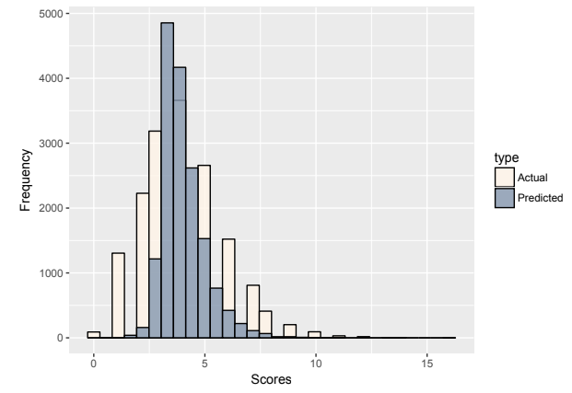
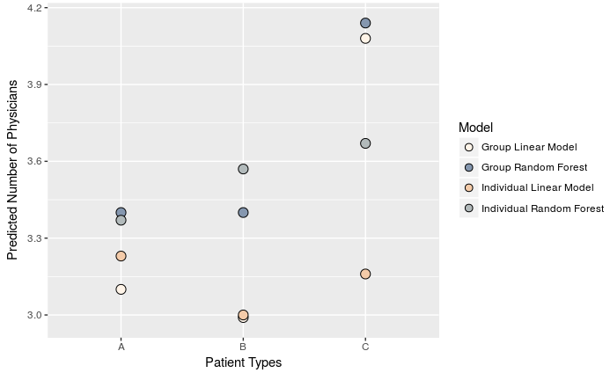
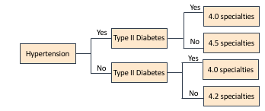
Developing a Patient-Level Measure of Medical Specialty Intensity for
Use in Assessing Quality of Coordination in Healthcare
Ella Hagopian, Tyler Radtke, Dr. Ashley Hodgson, Dr. Thomas Bernardin, St. Olaf College
Abstract
Average Square Error
Mean Square Error
Model R²
Individual Diagnoses | Random Forest | 3.34 | ––– | –––
 | CART | 3.57 | ––– | –––
 | Linear regression | ––– | 2.95 | 0.33
 | LASSO | ––– | 3.48 | 0.18
 | Backward selection | ––– | 2.98 | 0.30
 | Forward selection | ––– | 2.98 | 0.30
Grouped Diagnoses | Random Forest | 3.38 | ––– | –––
 | CART | 3.57 | ––– | –––
 | Linear regression | ––– | 3.62 | 0.14
 | LASSO | ––– | 3.62 | 0.14
 | Backward selection | ––– | 3.62 | 0.14
 | Forward selection | ––– | 3.62 | 0.14
Multiple chronic condition patients are not only common but also expensive; they made up 40% of Americans and 71% of national healthcare expenditure in 2017.^{1, 2} Although they are highly prevalent, patients with multiple chronic conditions are prone to more medical and coordination mistakes and are largely excluded from controlled medical studies.^{3, 4} This research aims to improve healthcare delivery and costs of care for multiple chronic condition patients by creating an objective score of patient interdisciplinarity. To create our score, we used random forest machine learning algorithms and linear regression to predict how many types of physician specialties a patient is likely to need. Our results may be used to compare types of facilities, investigate the optimal number of physicians for a given condition, and examine socioeconomic determinants of health.
Actual
Predicted
Figure 3. Histogram of predicted and actual specialty scores using linear regression for patients with hypertension and type II diabetes. Variation is due to patients with additional conditions.
Results and Future Research
We ultimately developed a scoring system to predict the number of physician specialties a patient will need.
The model with the lowest mean square error is a least-squares linear regression model (Table 1).
Our predicted scores have a narrower distribution than the actual scores but match the overall distribution well (Fig. 3).
Future researchers can use our score to compare facility types, assess innovations in care coordination and delivery, and estimate the optimal number of physicians.
Oncologist
Cardiologist
Table 1. Measures of the predictive accuracy for our models using individual-level diagnosis codes (e.g. Alzheimer’s disease) and diagnosis codes grouped by categories (e.g. diseases of the nervous system).
Hospitalist
Pulmonologist
Methods
Our data is a 5% sample of Medicare claims data from 2015.
We used three main models:
Random Forest: Generates hundreds of regression trees that vote on the predicted outcome.
CART: Generates one regression tree to predict the outcome.
Linear regression, including LASSO shrinkage, backward, and forward selection techniques.
Works Cited
Gerteis, J., Izrael, D., Deitz, D., LeRoy, L., Ricciardi, R., Miller, T., & Basu, J. (2014). Multiple Chronic Condition Chartbook. AHQR Publication No, Q14-0038. Rockville, MD: Agency for Healthcare Research and Quality.
Buttorff, C., Ruder, T., & Bauman, M. (2017). Multiple Chronic Conditions in the United States. Rand Corporation: Santa Monica, CA, USA.
Parekh, A.K., & Barton, M.B. (2010). The Challenge of Multiple Comorbidity for the US Health Care System. Journal of the American Medical Association, 303(13):1303–1304.
O’Malley, A. S., & Cunningham, P. J. (2009). Patient Experiences with Coordination of Care: The Benefit of Continuity and Primary Care Physician as Referral Source. Journal of General Internal Medicine, 24(2), 170–177.
Figure 2. Robustness check comparing predicted scores across four of our models. Type A represents a patient with hypertension, hyperlipidemia, and heart disease. Type B represents type II diabetes, depression, and COPD. Type C represents gastroesophageal reflux disease, chronic kidney disease, and atrial fibrillation.
Acknowledgements
Figure 1. Example of a simple CART model predicting the complexity score.
We would like to thank the Economics Department and the Collaborative Undergraduate Research and Inquiry program at St. Olaf College.

